Slide 1

Notes:
Cover Slide

Slide 2



LISTENING SKILLS

Slide 3

ORAL COMMUNICATION
What is Listening?
Notes:
Listening is receiving language through the ears. Listening involves identifying the sounds of speech and processing them into words and sentences. When we listen, we use our ears to receive individual sounds (letters, stress, rhythm and pauses) and we use our brain to convert these into messages that mean something to us.

Slide 4
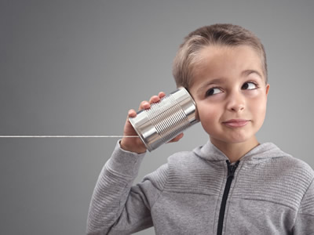
ORAL COMMUNICATION
Listening Skills
Notes:
Listening requires focus and attention. It is a skill that some people need to work at harder than others. People who have difficulty concentrating are typically poor listeners. To be an effective listener means that you not only listen or hear what is being said, you understand what you are listening to. Being able to understand what is being said provides you the opportunity to use that information to your benefit in all areas of your life.

Slide 5

ORAL COMMUNICATION
Power of Listening
Give 100% of your attention, or do not listen
Do not interrupt
Do not judge or evaluate
Do not impose your solutions
Ask more(good) questions
Reflect
Notes:
Power of Listening
“Listening resembles a muscle. It requires training, persistence, effort, and most importantly, the intention to become a good listener. It requires clearing your mind from internal and external noise — and if this isn’t possible, postponing a conversation for when you can truly listen without being distracted. Here are some best practices:
1.Give 100% of your attention, or do not listen. Put aside your smartphone, iPad, or laptop, and look at the speaker, even if they do not look back at you. In an ordinary conversation, a speaker looks at you occasionally to see that you’re still listening. Constant eye contact lets the speaker feel that you are listening.
2.Do not interrupt. Resist the urge to interrupt before the speaker indicates that they are done for the moment. In our workshop, we give managers the following instruction: “Go to someone at your work who makes listening very hard on you. Let them know that you are learning and practicing listening and that today, you will only listen for __ minutes (where the blank could be 3, 5, or even 10 minutes), and delay responding until the predetermined listening time is up, or even until the following day.” The managers are often amazed at their discoveries. One shared, “in 6 minutes, we completed a transaction that otherwise would have taken more than an hour”; another told us; “the other person shared things with me that I had prevented her from saying for 18 years.”
3.Do not judge or evaluate. Listen without jumping to conclusions and interpreting what you hear. You may notice your judgmental thoughts but push them aside. If you notice that you lost track of the conversation due to your judgments, apologize to the speaker that your mind was distracted, and ask them to repeat. Do not pretend to listen.
4.Do not impose your solutions. The role of the listener is to help the speaker draw up a solution themselves. Therefore, when listening to a fellow colleague or subordinate, refrain from suggesting solutions. If you believe you have a good solution and feel an urge to share it, use a question, such as “I wonder what will happen if you choose to do X?”
5.Ask more (good) questions. Listeners shape conversations by asking questions that benefit the speaker. Good listening requires being thoughtful about what the speaker needs help with most and crafting a question that would lead the speaker to search for an answer. Ask questions to help someone delve deeper into their thoughts and experiences. Before you ask a question, ask yourself, “is this question intended to benefit the speaker or satisfy my curiosity?” Of course, there is room for both, but a good listener prioritizes the needs of the other. One of the best questions you can ask is, “Is there anything else?” This often exposes novel information and unexpected opportunities.
6.Reflect. When you finish a conversation, reflect on your listening and think about missed opportunities — moments you ignored potential leads or remained silent versus asking questions. When you feel that you were an excellent listener, consider what you gained, and how you can apply this type of listening in more challenging circumstances.”

Slide 6
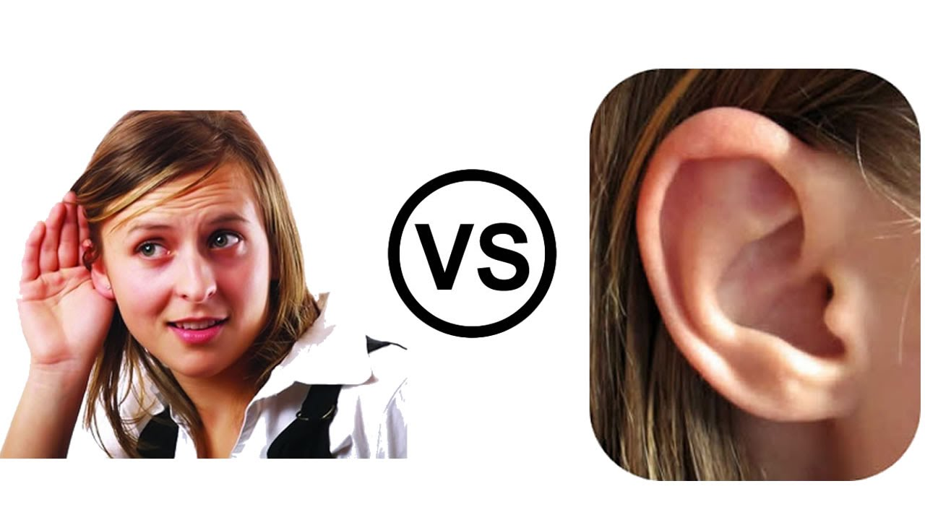
ORAL COMMUNICATION
Listening vs Hearing
Notes:
Hearing and listening differs in many different ways. Hearing goes through a different process and listening goes through a totally different process altogether. Below are some of the important differences which clearly explains the difference between hearing and listening. They are,
• An individual’s ability to perceive sounds, by receiving vibrations through ears, is called the hearing. Listening is something done consciously, that involve the analysis of the sounds you hear.
• The hearing is the primary and continuous in nature, i.e. the first and foremost stage is hearing, followed by listening and it occurs continuously. On the other hand, listening is temporary, as we cannot continuously pay attention to something for long hours.
• The hearing is physiological, which is through one of our senses in the living organisms. On the contrary, listening is a psychological (conscious) act.
• While hearing is a passive bodily process that does not involve the use of the brain. As opposed to listening, it is an active mental process, which involves the use of brain to draw meaning from words and sentences.
• Hearing involves receipt of the message through ears. Conversely, listening encompasses interpretation of the message received by ears.
• The hearing is an inborn ability but listening is a learned skill.
• In the hearing, we are not aware of the sounds that we receive, however in the case of listening, we are completely aware of what the speaker is saying.
• Hearing involves the use of only one sense i.e. ears. In contrast, listening, involves the use of more than one senses i.e. eyes, ears, touch etc. to understand the message completely and accurately.
• In the hearing, we are neither aware nor we have any control over the sounds we hear. On the other hand, in listening, we are aware of what the other person is saying and so we listen to acquire knowledge and receive information.
• Hearing does not require focus whereas listening does. Above are some of vital points which explains the difference between hearing and listening.

Slide 7
ORAL COMMUNICATION
Barriers to Listening
Selective Listening
Talking speed vs speed of thought
Lack of interest
Beliefs and attitudes
Reactions to speaker
Our preconceptions
The words we hear Over-Repetition of words
Physical distractions
Notes:
This handout talks through a number of different barriers to listening. As you’re reading through them – identify if any of the barriers apply to you. Do some apply when you are listening to certain people!
1.Selective listening We all listen selectively at some time or other. It is a necessary skill in order to survive in often very noisy environments, however our selectivity can sometimes be based on two things.
1)our preconceptions about the other person
2)our preconceptions about the importance of what’s being said
Identifying any preconceptions before the review meeting will help reduce this barrier.
2.Talking speed vs speed of thought There is a considerable difference between the speed at which people talk and the speed at which they think. The average person speaks at about 125 words per minute, whereas thinking speed is in the region of 500 words per minute. We all think a lot faster than we realise! The result is that when listening to someone we are continually jumping ahead of what is actually being said.
Try to avoid jumping to conclusions in the review meeting. Keep an open mind!
3.Lack of interest This could be due to lack of interest in the individual speaking or being distracted by things that are happening to you personally (e.g. poorly child, deadline for research project funding/reporting)
Remember, the review meeting is the opportunity for the reviewee to talk about themselves, their thoughts and feelings.
4.Beliefs and attitudes We all have opinions on a variety of current issues; we feel strongly about certain subjects; we value certain behaviours. How do you react when someone
inadvertently challenges your beliefs and attitudes? Try to avoid getting emotional particularly in the review situation, remember, the review is about the reviewee not you!

Slide 8
ORAL COMMUNICATION
Barriers to Listening
Reactions to speaker
Our preconceptions
The words we hear Over-Repetition of words
Physical distractions
Notes:
5.Reactions to speaker Our reactions to the person speaking rather than what they are saying can cause us to listen less effectively.
6.Our preconceptions Our preconceptions often mean we don’t even give another person a chance to speak. We can prejudge what they have to say. The implication of this behaviour is that it implies we don’t value what they might have to offer.
7.The words we hear Over-repetition of words and phrases is one distraction, the use of unfamiliar (e.g. jargon) words is another. Another important point to remember is that words can mean different things to different people. Good – to one person may mean only just acceptable, to another it might mean ‘perfect’.
8.Physical distractions This can come in a number of different guises and ranges from the background noises that are going on (i.e. a telephone ringing or a fire engine racing down the road), whether we are physically comfortable (i.e. too warm, too cold, the seat is uncomfortable – too high/too low, thirsty), the lighting in the room, to distracting pictures on the wall. Some distractions are within our control (i.e telephone calls) and where possible it’s important to try and stop them from becoming distractions (e.g. divert all calls).

Slide 9
ORAL COMMUNICATION
Bad Listening Habits
Not paying attention
Pseudo-listening
Listening but not Hearing
Rehearsing
Interrupting
Hearing what is Expected
Feeling Defensive
Listening for a point of Disagreement
Notes:
Most people spend more time listening than they spend on any other communication activity, yet a large percentage of people never learn to listen well.One reason is that they develop poor listening habits that continue with them throughout life. The following list contains some of the most common bad listening habits:
1.Not Paying Attention. Listeners may allow themselves to be distracted or to think of something else.Also,not wanting to listen often contributes to lack of attention.
2.“Pseudo‐listening”. Often,people who are thinking about something else deliberately try to look as though they are listening.Such pretense may leave the speaker with the impression that the listener has heard some important information or instructions offered by the speaker when this is not really true.
3.Listening But Not Hearing. Sometimes a person listens only to facts or details or to the way in which they are presented and misses the real meaning of the communication.
4.Rehearsing. Some people listen until they want to say something;then they stop listening,start rehearsing what they will say and wait for an opportunity to respond.

Slide 10
ORAL COMMUNICATION
Bad Listening Habits
Interrupting
Hearing what is Expected
Feeling Defensive
Listening for a point of Disagreement
Notes:
5.Interrupting. The listener does not wait until the complete meaning can be determined,but interrupts so forcefully that the speaker stops mid‐sentence.
6.Hearing What is Expected.People frequently think that they heard speakers say what they expected them to say.Alternately,they refuse to hear what they don’t want to hear.
7.Feeling Defensive.The listeners assume that they know the speaker’s intention or why something was said,or for various other reasons,they expect to be attacked.
8.Listening for a Point of Disagreement. Some listeners seem to wait for the chance to attack someone.They listen intently for points on which they can disagree.

Slide 11
ORAL COMMUNICATION
Active Listening
Positive Reinforcement
Remembering
Questioning
Reflection
Clarification
Summarisation
Notes:
1.Positive Reinforcement
Although a strong signal of attentiveness, caution should be used when using positive verbal reinforcement.
Although some positive words of encouragement may be beneficial to the speaker the listener should use them sparingly so as not to distract from what is being said or place unnecessary emphasis on parts of the message.
Casual and frequent use of words and phrases, such as: ‘very good’, ‘yes’ or ‘indeed’ can become irritating to the speaker. It is usually better to elaborate and explain why you are agreeing with a certain point.
2.Remembering
The human mind is notoriously bad at remembering details, especially for any length of time.
However, remembering a few key points, or even the name of the speaker, can help to reinforce that the messages sent have been received and understood – i.e. listening has been successful. Remembering details, ideas and concepts from previous conversations proves that attention was kept and is likely to encourage the speaker to continue. During longer exchanges it may be appropriate to make very brief notes to act as a memory jog when questioning or clarifying later.
3.Questioning
The listener can demonstrate that they have been paying attention by asking relevant questions and/or making statements that build or help to clarify what the speaker has said. By asking relevant questions the listener also helps to reinforce that they have an interest in what the speaker has been saying.
4.Reflection
Reflecting is closely repeating or paraphrasing what the speaker has said in order to show comprehension. Reflection is a powerful skill that can reinforce the message of the speaker and demonstrate understanding.
5.Clarification
Clarifying involves asking questions of the speaker to ensure that the correct message has been received. Clarification usually involves the use of open questions which enables the speaker to expand on certain points as necessary.
6.Summarisation
Repeating a summary of what has been said back to the speaker is a technique used by the listener to repeat what has been said in their own words. Summarising involves taking the main points of the received message and reiterating them in a logical and clear way, giving the speaker chance to correct if necessary.

Slide 12
ANALYTICAL WRITING
THANK YOU

